Slide 1
GUEST ALARM SYSTEM APPLIED IN SMART HOME
Tran Quoc Thanh
CH2001035
Tran Quoc Thanh – CH2001035
Nguyen Thanh An -
Vo Be Ngoan -
Notes:
We designed this template so that each member of the project team has a set of slides with its own theme. Members, here’s how you add a new slide to just your set:
Mark where you want to add the slide: Select an existing one in the Thumbnails pane, click the New Slide button, then choose a layout. The new slide gets the same theme as the other slides in your set.
Careful! Don’t annoy your fellow presenters by accidentally changing their themes. That can happen if you choose a different theme from the Design tab, which changes all of the slides in the presentation to that look.

Slide 2
Content
Objective
System design
Compare and select components (camera, IoT node hardware, algorithm)
Experiment result
Summary

Slide 3
Objective
Design system architect for guest alarm system applied in smart home
Compare and choose hardware for IoT node and face recognition algorithm
Experiment: compare hardware and algorithms in term of speed and accuracy with different conditions

Slide 4
System design
Trần Quốc Thành

Slide 5





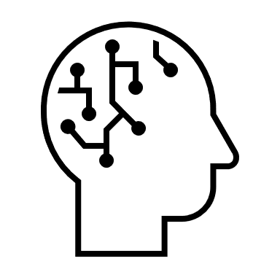
System’s components
Where are AI algorithms stored?
What kind of data is transferred between components
Cloud server
End users
IoT nodes
AI algorithm 1
Face detection
AI algorithm 2
Face recognition

Slide 6
Option 1: AI algorithms on cloud
Advantage
Disadvantage
Utilize cloud’s computational power
Low technical requirements lead to low cost of IoT node
Utilize big data collected from users
Require large network bandwidth
System stop working when network unavailable
Required cloud’s computational power and storage power increase rapidly with number of IoT nodes

Slide 7
Solution 2: AI algorithms on IoT node
Advantage
Disadvantage
Minimal amount of network bandwidth required
Local IoT node (and connected actuator if any) can still work without network connection
User’s privacy is secured
High technical requirements lead to high cost of IoT node
Limited AI algorithms due to IoT node’s computational and storage capability
Challenging to ensure security

Slide 8
Solution 3: Hybrid (face detection on IoT node, face embedding and recognition on cloud)
Advantage
Disadvantage
Minimal network bandwidth is required
Sophisticated face embedding algorithm can be used
Better security (important model stays on cloud)
Reduced requirements on cloud’s computational and storage
System stop working when network is unavailable

Slide 9
System design following solution 2
Cloud server
Giải thuật AI được hiện thực hóa ngay trên IoT node
End users
IoT nodes

Slide 10
IoT node hardware and algorithm
Trần Quốc Thành

Slide 11
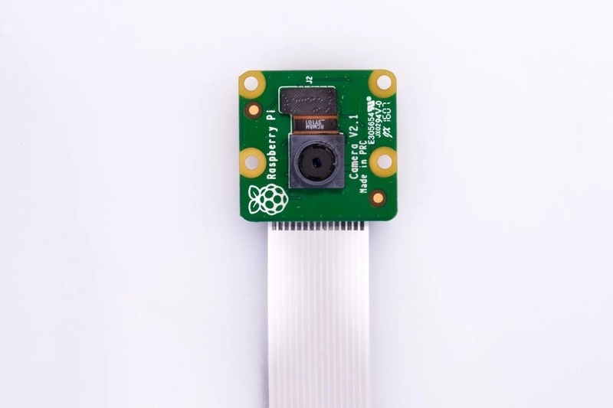
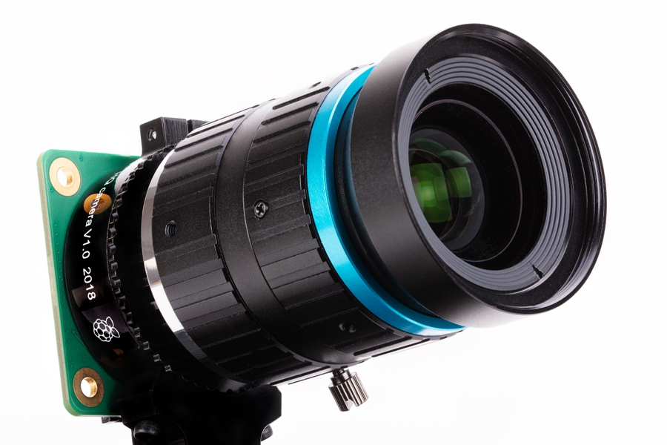
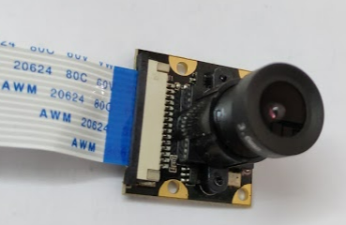
Camera
Chi tiết | Pi camera V2 | HQ camera | Chosen camera
Size | 25x24x9mm | 38x38x18.4mm | 30x30x40mm
Still resolution | 8Megapixels | 12.3Megapixels | ?
Video modes | 1080p30 720p60 | 1080p30 720p60 | 512p30
Optical size | 1/4,0’’ | 1/4,0’’ | 1/2,7’’
Focal length | 3.04mm | Depends on lens | 3.6mm
Bit depth | 10 | 12 | ?
Price | 25$ | 50$ | 25$

Slide 12

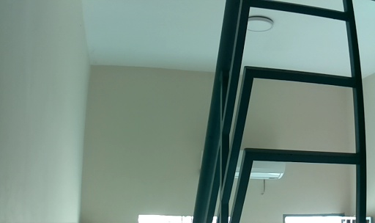
Camera
Distance: 0.5m
Distance: 4m

Slide 13
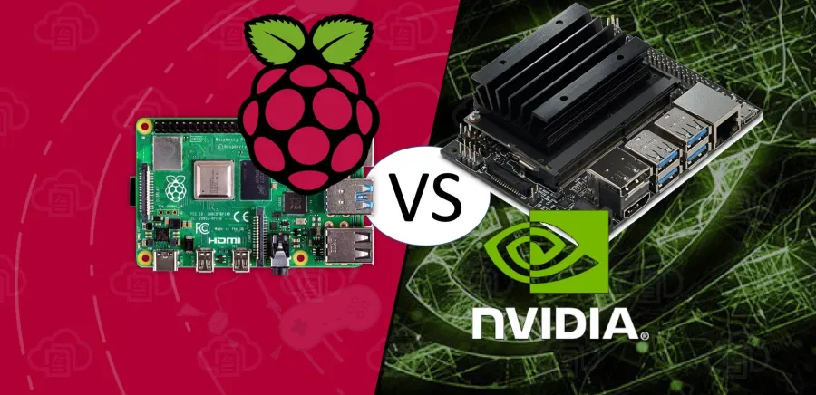
Raspberry Pi 4 vs Nano Jetson
This picture and table below based on information from: Raspberry Pi 4 Vs NVIDIA Jetson Nano Developer Kit | Build5Nines

Slide 14
Raspberry Pi 4 vs Nano Jetson
Item | Raspberry Pi 4 | Nano Jetson
CPU | Quad-core ARM Cortex-A72 64-bit @ 1.5 Ghz | Quad-Core ARM Cortex-A57 64-bit @ 1.42 Ghz
GPU | Broadcom VideoCore VI (32-bit) | NVIDIA Maxwell w/ 128 CUDA cores @ 921 Mhz
Memory | 4 GB LPDDR4 | 4 GB LPDDR4
Networking | Gigabit Ethernet / Wifi 802.11ac | Gigabit Ethernet / M.2 Key E (for Wifi support)
Display | 2x micro-HDMI (up to 4Kp60) | HDMI 2.0 and eDP 1.4
USB | 2x USB 3.0, 2x USB 2.0 | 4x USB 3.0, USB 2.0 Micro-B
Other | 40-pin GPIO | 40-pin GPIO
Video Encode | H264(1080p30) | H.264/H.265 (4Kp30)
Video Decode | H.265(4Kp60), H.264(1080p60) | H.264/H.265 (4Kp60, 2x 4Kp30)
Camera | MIPI CSI port | MIPI CSI port
Storage | Micro-SD | Micro-SD
Price | $55 USD | $99 USD

Slide 15

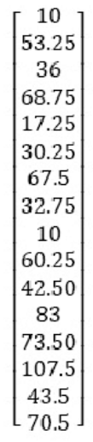
AI algorithm
One time processing
(for each picture of each family member)
Real time processing
(2nd step only process when a face is detected)
Compare
(Euclid distance) and decide

Slide 16
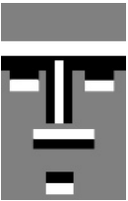
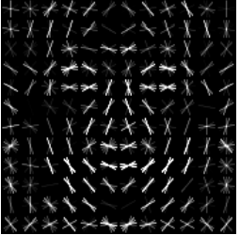
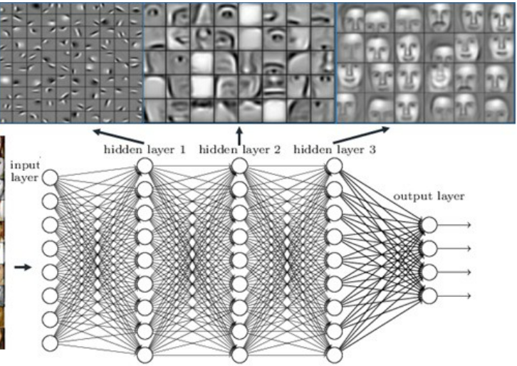
AI Algorithm – face detection
Item | Haar-cascade | Histogram of Oriented Gradient (HOG) | CNN
Idea | Look for simple pattern through image on different scale | Use oriented gradient (white arrow) to look for pattern through image on different scale | Hierarchy of abstract features are learnt from deep network. CNN ensure faces with different position/scale on image are detected
Model size | Very small | Small | Big
Speed | Very fast | Fast | Slow (can be speed up by VGU)
Quality | Acceptable | State of the art | Highest
The information in this table is based on Microsoft Word - Nicolas Delbiaggio - 06.05.17 with template.docx (core.ac.uk)

Slide 17
AI Algorithm – face embedding
Item | Eigenfaces | Fisherfaces | CNN
Idea | Using PCA (principle component analysis) to compress high dimensional image into below 100-dim vector | Also use PCA but consider also the average of each class (each person) using Linear Discriminant Analysis for better result | A pretrained neural network on faces can be used for face embedding in forward propagation. The output from 2nd last fully connected layer is the needed embedding vector
Model size | No model needed | No model needed | Big
Speed | Very fast | Very fast | Slow (can be speed up by VGU)
Quality | Acceptable | Acceptable | Very good
Use RESNET model from dlib library (RESNET-29): link
Dataset include 3 million faces of about 7,500 individual worldwide.
The information in this slide is based on Microsoft Word - Nicolas Delbiaggio - 06.05.17 with template.docx (core.ac.uk) and A Study of Face Embedding in Face Recognition (calpoly.edu)

Slide 18
Server and mobile app
Nguyen Thanh An

Slide 19
Supporting content
Heading
Heading
List item
List item
List item
List item
List item
List item

Slide 20
Data observations

Slide 21
Data Observations
Optional statement

Slide 22
Experiment result
Tran Quoc Thanh

Slide 23
Experiment 1: Speed
Face detection algorithm (HOG) run very fast
Face detection algorithm should be independent of number of reference faces (of family members)
Face embedding algorithm (RESNET-29) run very slow (FPS reduced from ~22 to 2.6). IoT node with GPU can improve performance.
Time to compare guest face to references face doesn’t matter up to 1,000 reference faces. Above that, it starts to affect performance (2.5 FPS -> 1.9FPS)

Slide 24
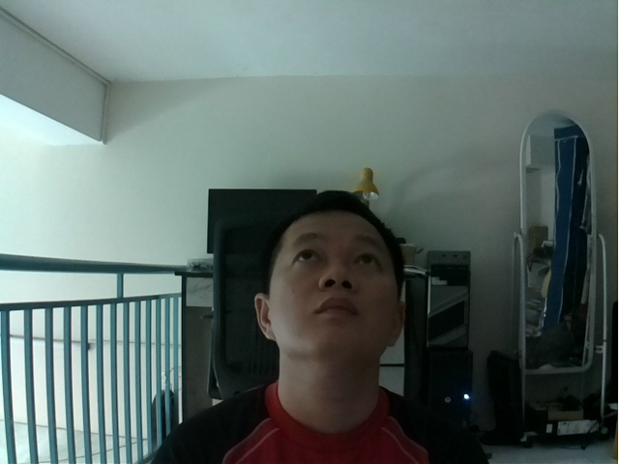
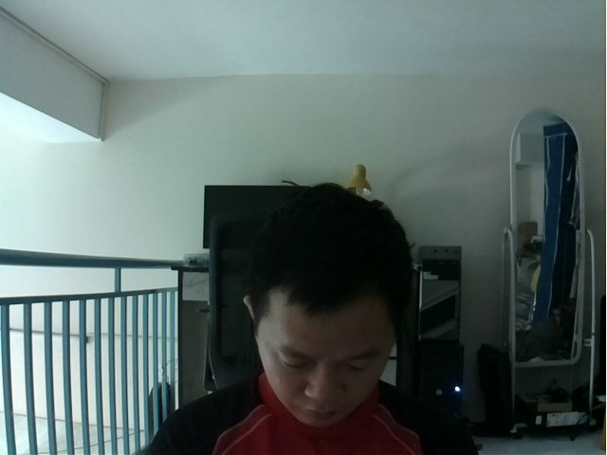
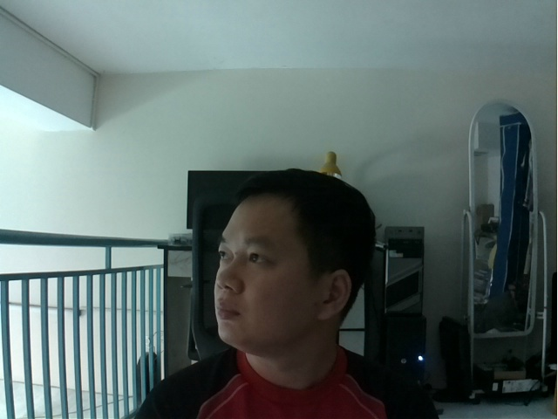
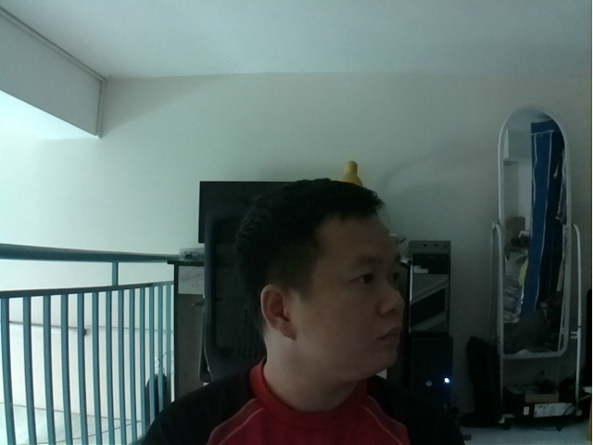
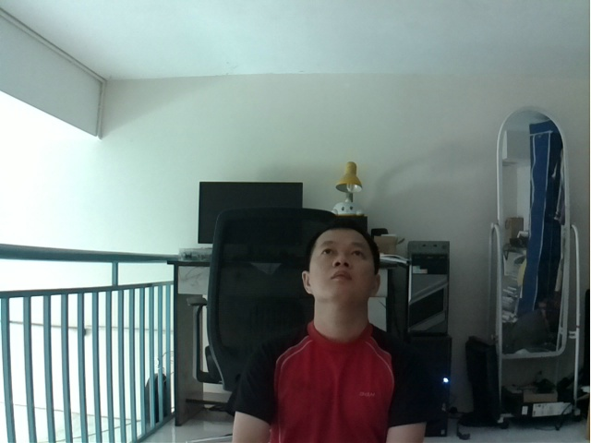
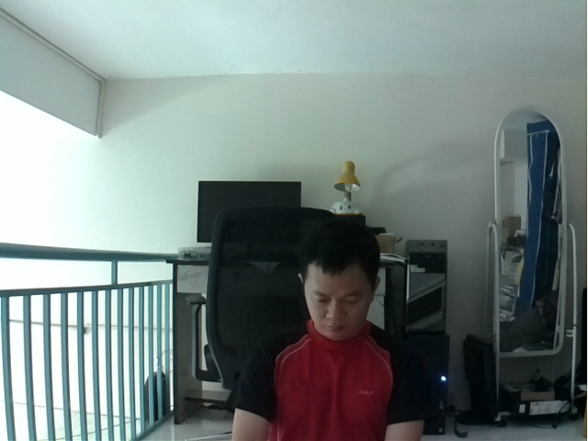
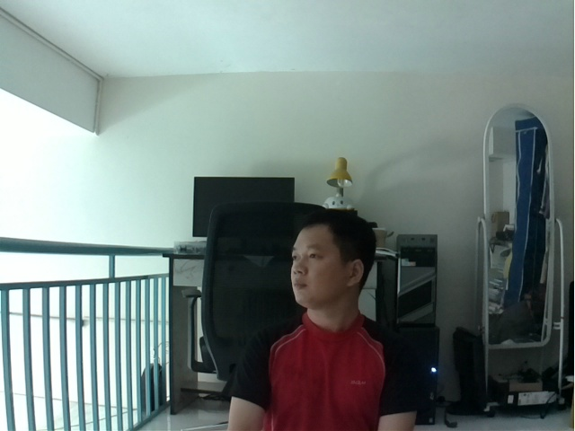
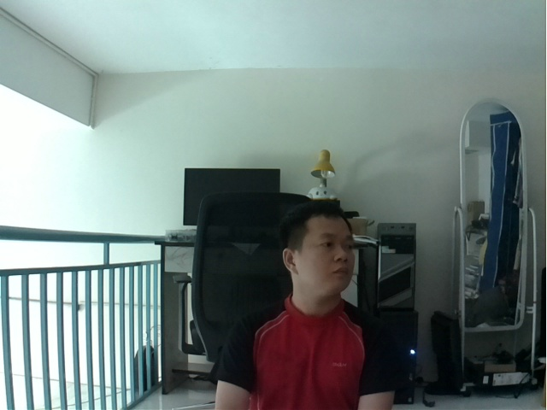
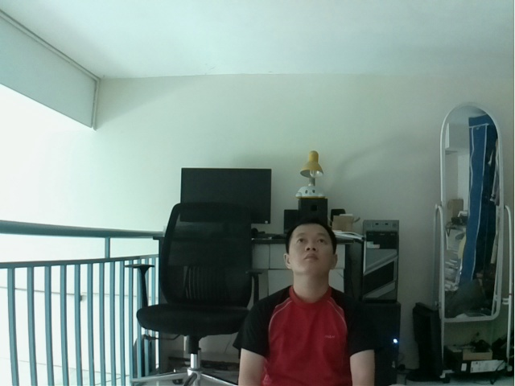
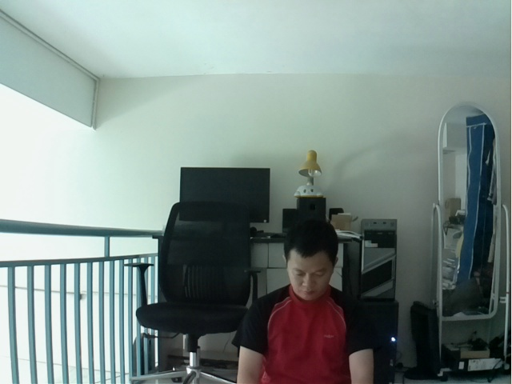
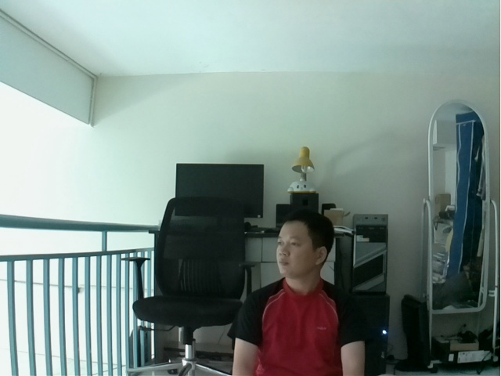
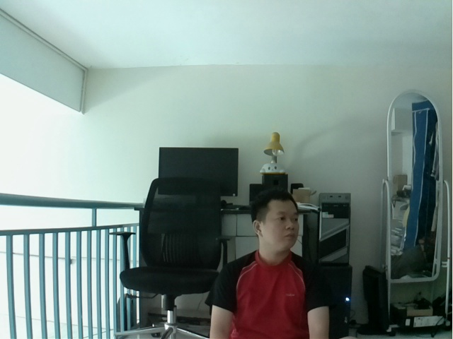
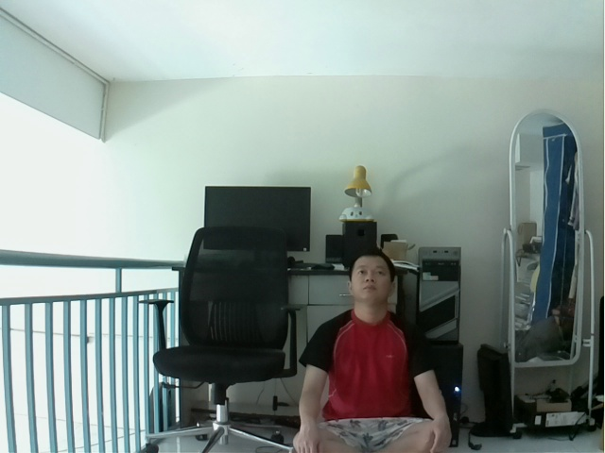
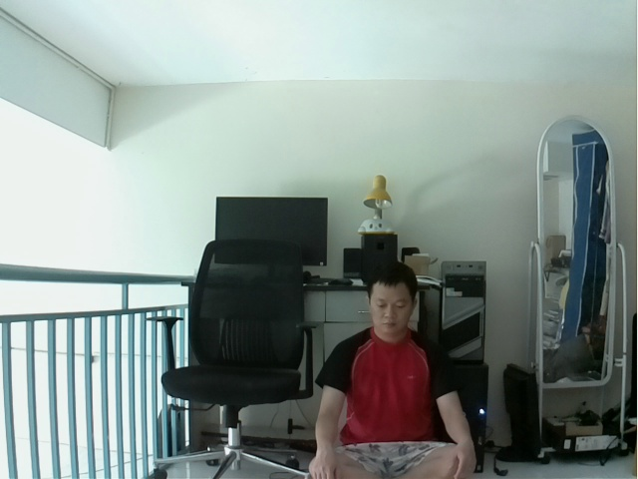


Experiment 2 – face detection ability
Distance [m] | Up [degree] | Down [Degree] | Left [Degree] | Right [Degree]
0.6 | 60 | 45 | 70 | 70
1.2 | 60 | 45 | 65 | 65
1.8 | 45 | 45 | 45 | 45
2.1 | 30 | 30 | 35 | 35
At 0.6m, the range of angle so that face is detected is quite big
At 2.1m, the range of angle so that face is detected is reduced to around 30degree.
Within these ranges, faces are detected 100% with different emotion.
Outside these range, detectability significantly reduced

Slide 25

Experiment 2 – face detection ability (continue)
Because of camera quality, with dimmer light (early in the morning or later afternoon), picture from camera is black.
Even with better light and camera can capture reasonable picture, system can’t detect face.

Slide 26
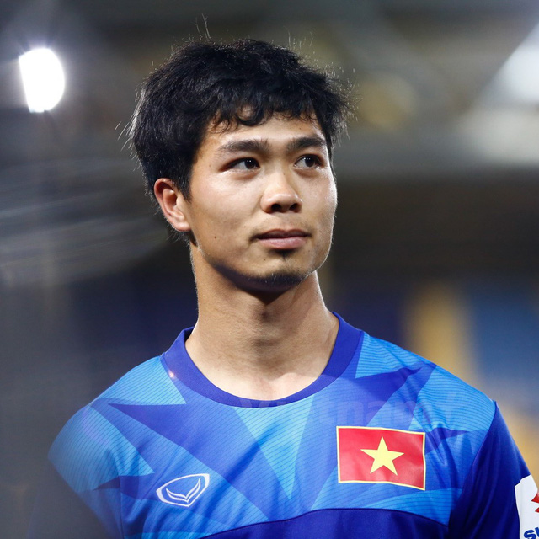

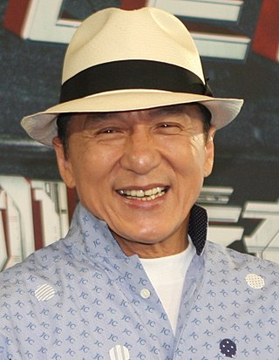
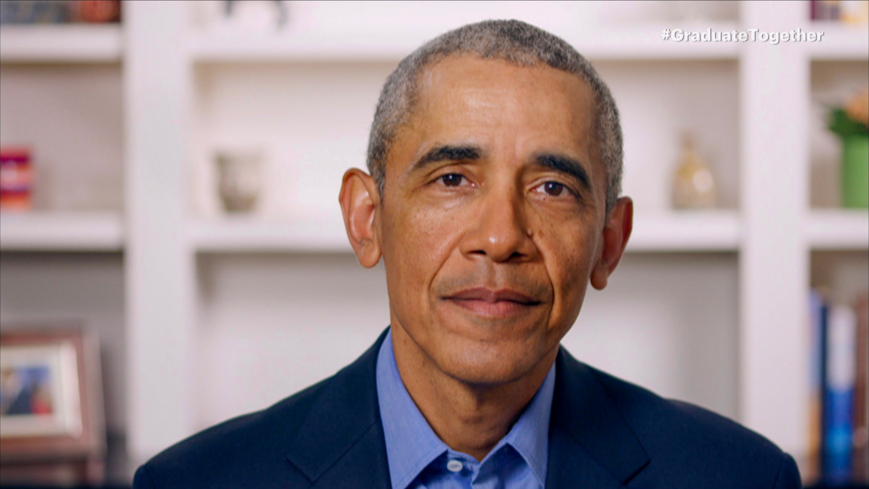
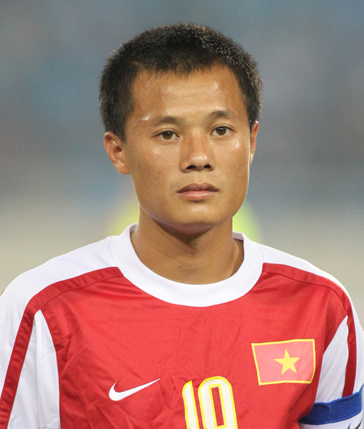
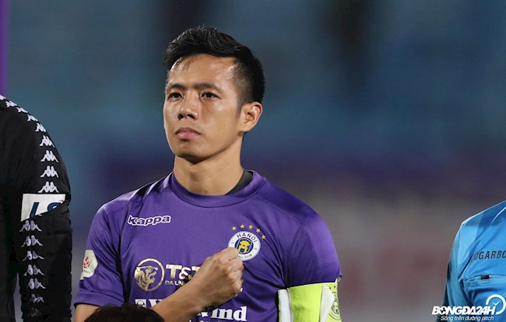


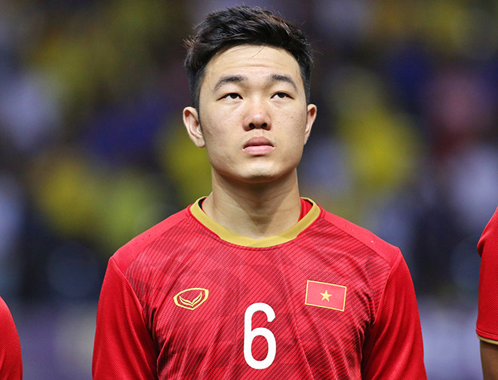
Experiment 3 – recognition accuracy
The test is done for only 10 people below
With only one reference picture/person, the accuracy is about 50%
With 2 pictures/person, the accuracy is 100% (with all distances and angles that a face is detected)

Slide 27
Summary
Trần Quốc Thành

Slide 28
Summary
Done
Study, design and build a guest alarm system applied in smart home including IoT node, server and mobile app.
Conduct experiment to find the performance of built system (in term of speed, face detection and face recognition capability)
Future work
Conduct experiment with Jetson Nano and compare with Raspberry Pi 4
Conduct experiment with other face embedding algorithms and compare it with RESNET-29
Quantify lighting condition
More accuracy angle measurement
What can we do better:
Team work (forming–storming–norming–performing)

